Slide 1
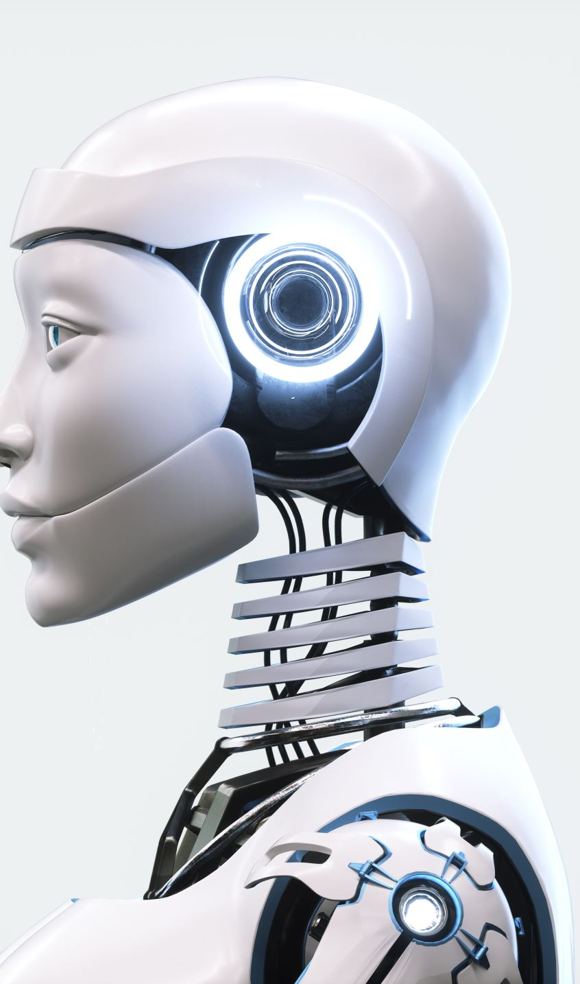
Learning from Examples
Introduction to Artificial Intelligence

Slide 2
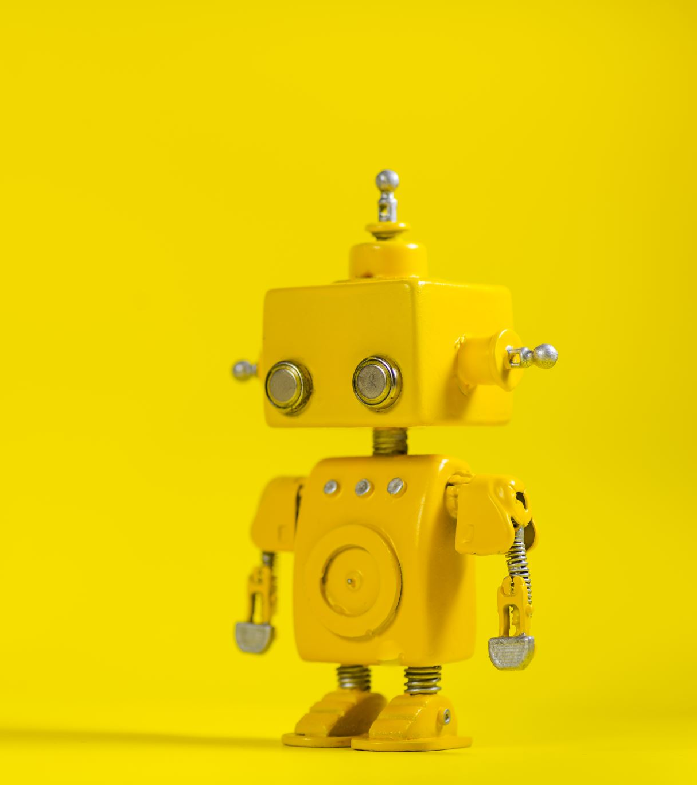
What is Artificial Intelligence (AI) ?
Artificial intelligence (AI) is the ability of machines to replicate human behavior.
Ability to learn, think, and make decisions as we humans do.

Slide 3
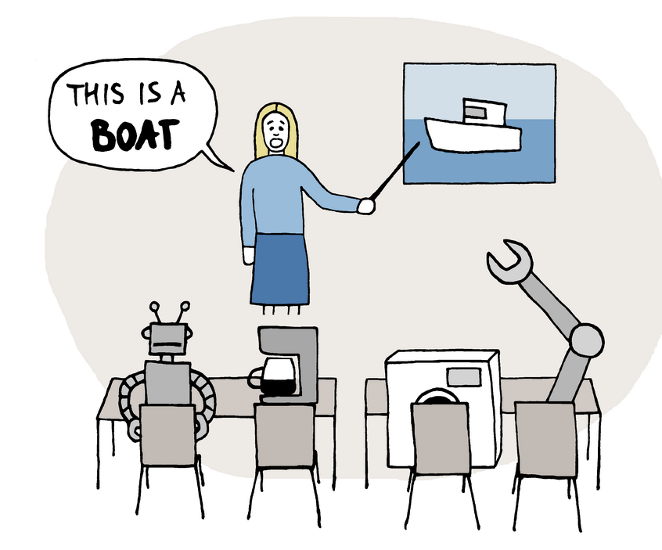
What is machine learning
Machine learning (ML) is a subset of AI that enables computers to learn without humans programming them. Machine learn from data and patterns

Slide 4

How have you interacted with AI or machine learning in your day-to-day activities?

Slide 5





Selfie Filters
Other Machine learning Use cases
Hey Siri/Google
Cab Booking
Play Store Recommendation
Face Unlock in
Smartphones
Gmail Spam
Alert

Slide 6
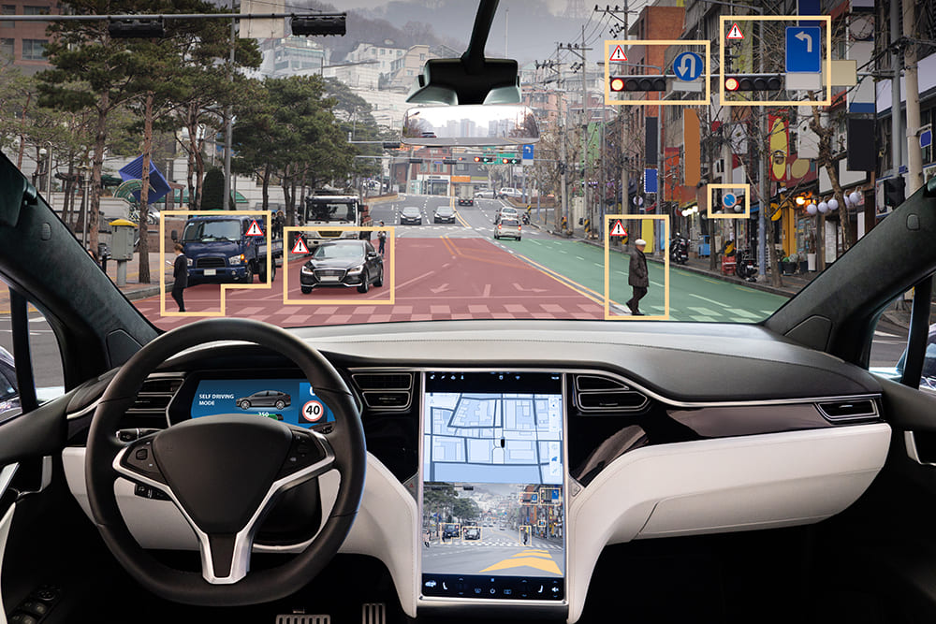
How does Tesla use Machine Learning?

Slide 7
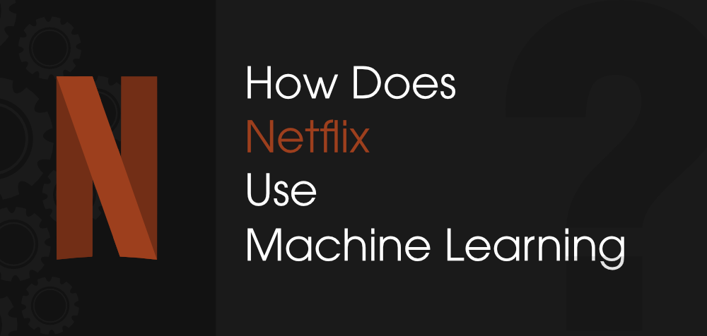

Slide 8


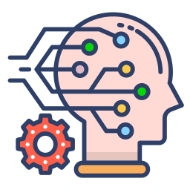
Supervised Machine Learning
These are apples
Training Dataset
Machine now understands how
apples and bananas look like
Learning process
Predictions
It will either be an
apple or banana
Machine learning
model
Trained Machine Learning
Model
These are Bananas
Test Dataset
Supervised Machine learning models has labels for training dataset

Slide 9
Unsupervised Machine Learning
output
Input Unlabeled Data
Machine learning
model
Unsupervised Machine learning models has no labels for dataset

Slide 10
Activity Discussion
Check out this AI doodling tool by Google
https://quickdraw.withgoogle.com/
How do you think it works?
How do you think they built this?
What data and tools might you need if you wanted to make your own?

Slide 11
Words to remember
Training Data
Labels
Test Data
Supervised Learning
Unsupervised Learning

Slide 12
Regression Algorithm – Linear Regression
The word “Linear” means anything which goes on the straight (at least somewhat) line.
Regression is determining the strength and character of the relationship between the two variables.

Slide 13
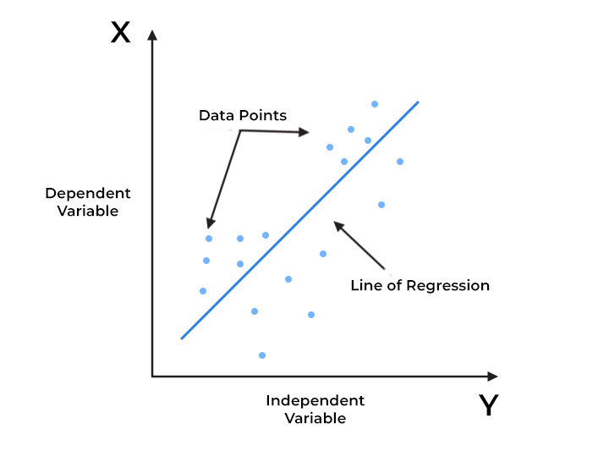
Linear regression is a way to explain the relationship between a dependent variable and one or more explanatory (independent) variables using a straight line.

Slide 14
Classification Algorithm – Support Vector Machine
Support Vector Machine (SVM) is a supervised machine learning model that uses classification algorithms for two-group classification problems.
After giving an SVM model sets of labeled training data for each category, they’re able to categorize new
Practical: SVM demonstration with colored balls

Slide 15
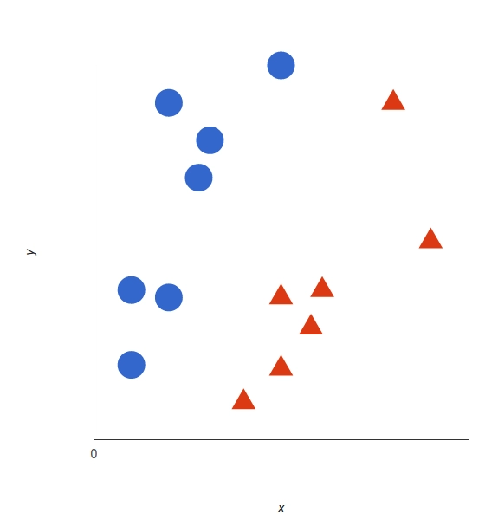
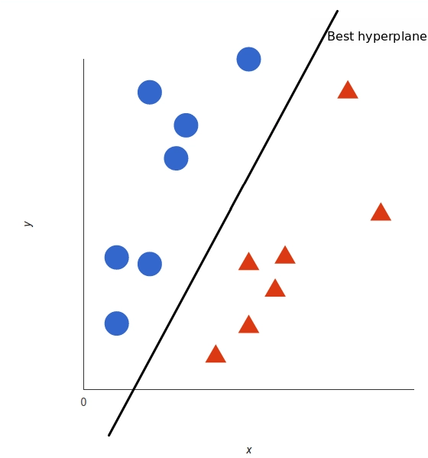
How SVM works
In 2D, the best Hyperplane is simply a line

Slide 16
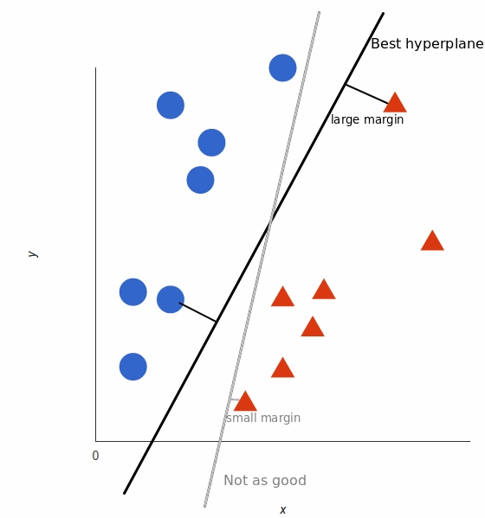
How SVM works
The best hyperplane is the line whose distance to the nearest element of each tag is the largest.

Slide 17
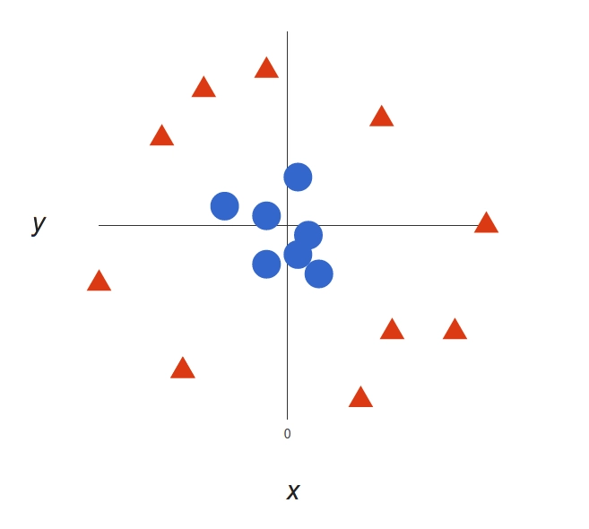
How SVM works
There’s no linear decision boundary.
A single straight line can’t separate both tags

Slide 18
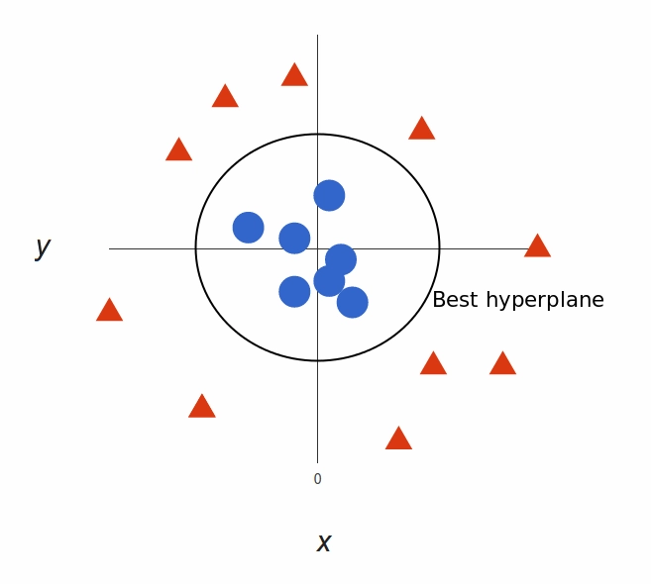
How SVM works
Add a third dimension. Up until now we had two dimensions: x and y. We will create a new z dimension. Instead of a two-dimensional space we have a three-dimensional space now.

Slide 19
Activity Discussion 2
https://ml-playground.com/
What are possible applications of SVM?

Slide 20
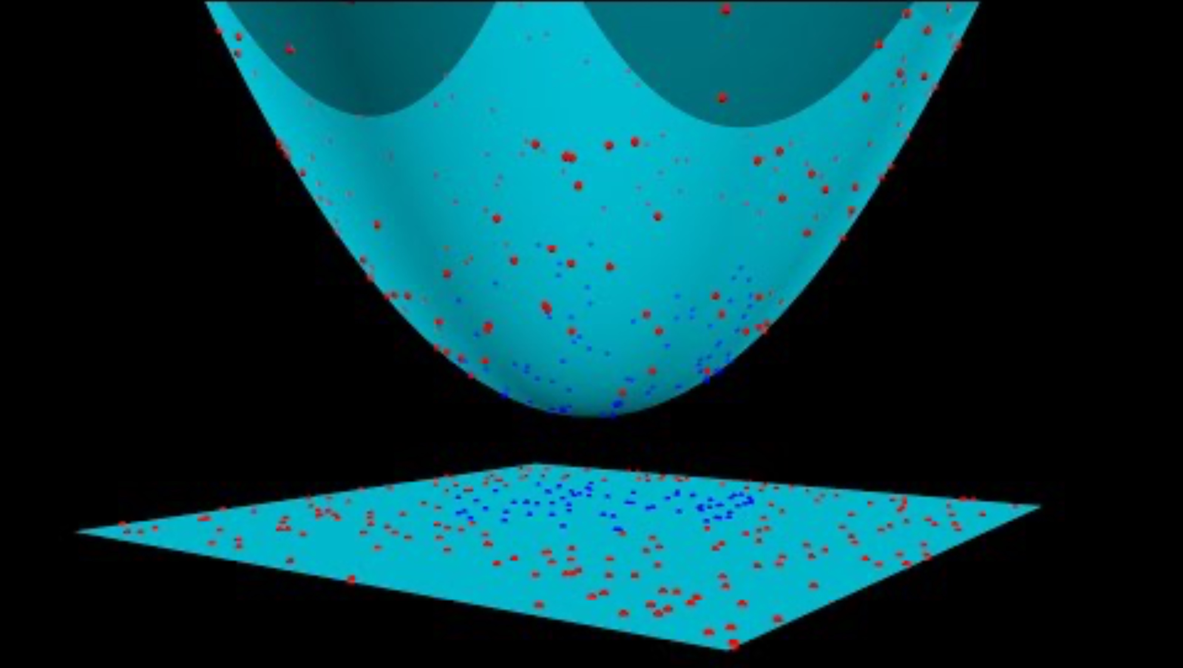
How SVM works

Slide 21
Words to Remember
Hyperplane
Margin
Variables
Support Vectors
Feature

Slide 22

Reinforcement Learning
Reinforcement Learning (RL) is the science of decision making. It is about learning the optimal behavior in an environment to obtain maximum reward. This optimal behavior is learned through interactions with the environment and observations of how it responds, similar to children exploring the world around them and learning the actions that help them achieve a goal.

Slide 23
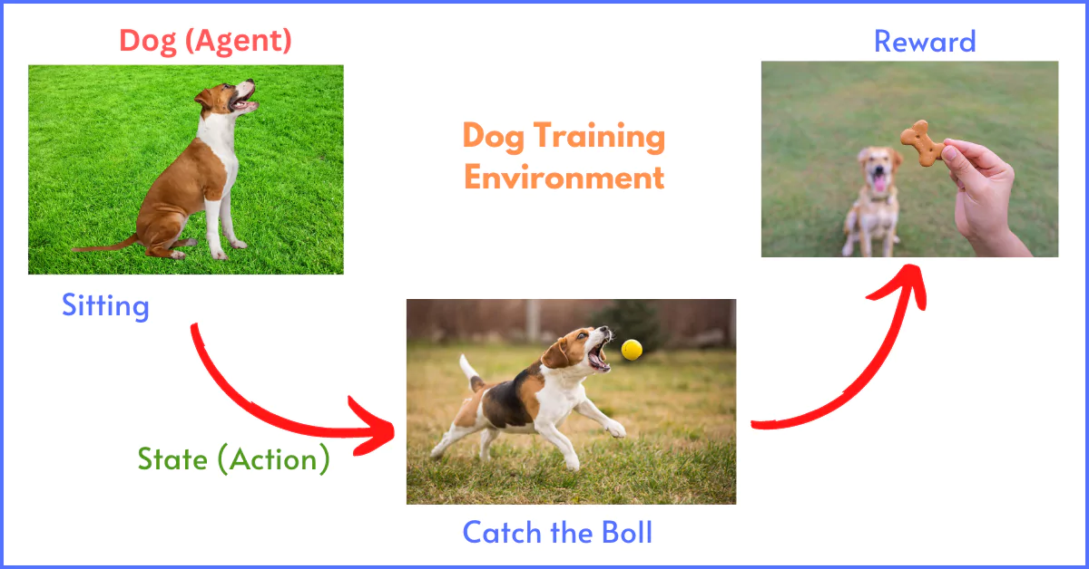

Slide 24
Activity 3
https://teachablemachine.withgoogle.com/train

